Slide 1
Open methods

Slide 2
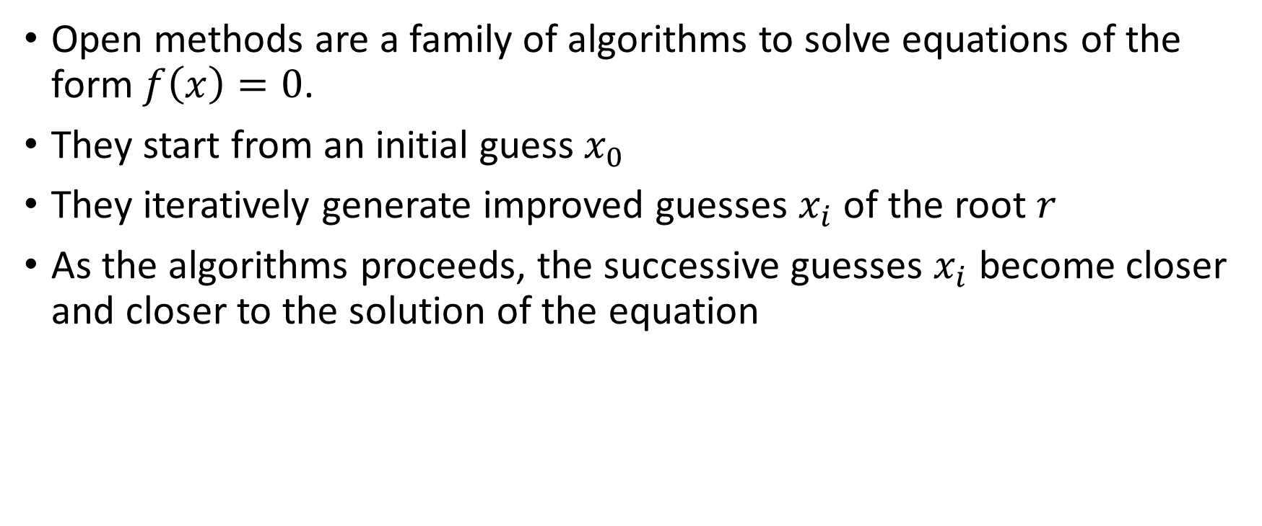
Open methods are a family of algorithms to solve equations of the form $f\left(x\right)=0$.
They start from an initial guess$x_{0}$
They iteratively generate improved guesses $x_{i}$ of the root $r$
As the algorithms proceeds, the successive guesses $x_{i}$ become closer and closer to the solution of the equation
Notes:
In this lecture we are going to discuss a new family of methods to solve numerically none-linear equations in one variable : the so-called open methods.
These methods aim to provide a series of approximations which will, as the algorithm is proceeding, become closer and closer to the solution of the equation.
To do this one has first to feed the algorithm with an initial guess xo. Note that the algorithm doesn't tell you how to find such an initial guess.
This has to be done with other methods.
For example by plotting the function, with some educated guesses or any other viable solution.
The algorithm will use this initial guess to compute an improved approximation of the solution of the equation.
The algorithm will proceed iteratively and provide a series of approximations xi.
As the algorithm proceeds, these approximations become closer and closer to the solution of the equation
In this semester we are going to discuss two examples of open methods: the fixed point iteration and the Newton-Raphson method.

Slide 3





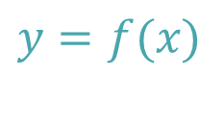
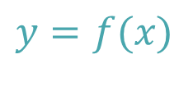

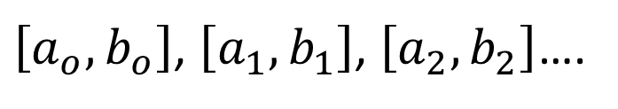



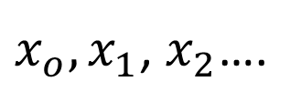
Bracketing versus open methods
$$y$$
$$y$$
$$y=f(x)$$
$$y=f(x)$$
$$a_{i}$$
[
]
$$r$$
$$x$$
$$r$$
$$x_{i}$$
$$x$$
$$b_{i}$$
$\left[a_{o},b_{o}\right]$, $\left[a_{1},b_{1}\right]$, $\left[a_{2},b_{2}\right]$….
$x_{o},x_{1}$, $x_{2}$….
Notes:
Let us compare bracketing and open methods
As we learned previoulsey, bracketing methods produce a series of intervals [ai,bi] containing the root r and becoming smaller and smaller in order to locate more and more precisely the root
Open methods do not produce such intervals. They only produce a sequence of numbers xi, which will , under the right conditions, become closer and closer to the root r.
This difference in strategy has several consequences.

Slide 4
Challenge one: error estimation
Algorithm
x_{i}
x_{i+1}
x_{r}=x_{i+1}
Error < TOL
Error > TOL
Notes:
This first important change compared to bracketing method is the issue of estimating the error.
In each iteration open methods will only provide an approximation xi of the solution of the equation.
Compared to bracketing methods, we don’t anymore have an interval bracketing the solution.
How can we estimate the error between the computed approximation xi and the solution r of the equation?
We will have to develop a new methodology to answer this question.
Note that the algorithms will not provide such error estimations. They only provide a series of approximations xi.
Estimating the errors will have to be done independently of the algorithm.
We will learn this progressively in the coming lectures.

Slide 5




Challenge 2: convergence
Open methods may or may not converge to the desired solution
$$x_{i}$$
$$x_{i}$$
$$i$$
$$i$$
Converging algorithm
Not converging algorithm
Notes:
Another significant difference of open methods compared to bracketing methods is that they do not always converge.
For bracketing methods, if we did satisfy all conditions so the algorithm can be applied, we knew that the algorithm will converge.
In the case of open methods, even if we satisfy all requirements, the algorithm may not converge.
Luckily, compared to the problem of error estimation, the problem of convergence is simpler to tackle.
If one plots the sequence of number xi in function of the number of iterations i, it is relatively straight forward to see if the algorithm converges or not.
For a converging algorithm the sequence will stabilize to a constant value
For a not converging algorithm the sequence will not stabilize to a constant value.
Let us insist on an important point. The fact that an algorithm is converging to a constant value, does not imply that this value is indeed the desired root. It could converge to a constant value different than the root r. In this case we will end up with a systematic error.
The key point to take away is that such convergence plots do not guarantee that you are converging to the exact value r. They only confirm that the algorithm is converging to something.

Slide 6
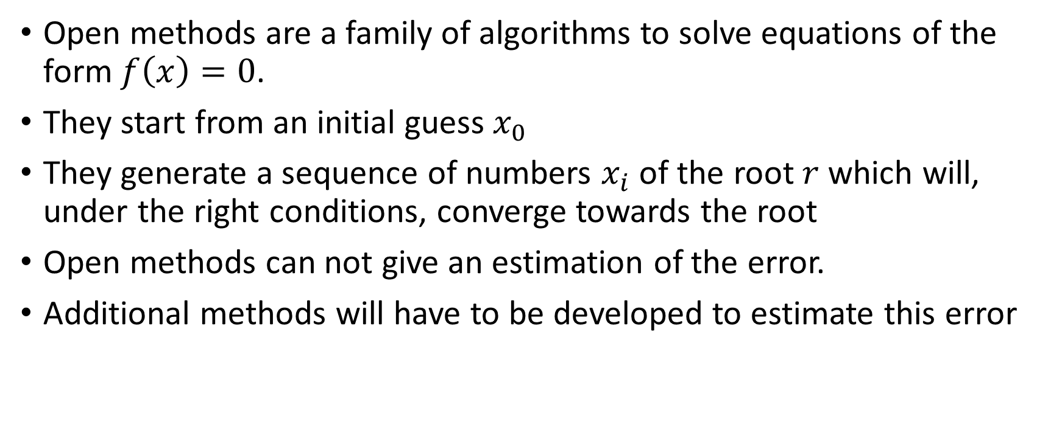
Summary
Open methods are a family of algorithms to solve equations of the form $f\left(x\right)=0$.
They start from an initial guess$x_{0}$
They generate a sequence of numbers $x_{i}$ of the root $r$ which will, under the right conditions, converge towards the root
Open methods can not give an estimation of the error.
Additional methods will have to be developed to estimate this error
Notes:
Let us summarize the key findings
Open methods are a family of algorithms to solve equations of the form $f\left(x\right)=0$.
They start from an initial guess$x_{0}$
They generate a sequence of numbers $x_{i}$ of the root $r$ which will, under the right conditions, converge towards the root
Open methods can not give an estimation of the error.
Additional methods will have to be developed to estimate this error

